Slide 1

Current Regulator
Chris Tomaskovic

Slide 2
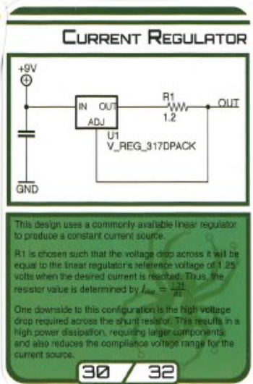
Circuit Function
A current regulator is used to produce a constant current in a circuit. It does this by regulating the other factors that could affect the current. Since I = V/R, maintaining a constant current can be difficult since the voltage and resistance can change throughout a circuit. To combat this, a current regulator will modify the voltage or resistance to maintain a constant current. In the diagram on the circuit card, there is a voltage regulator that will keep changing the voltage until it reaches 1.25v. This means that the voltage stays constant. Since I = 1.25/R, we add the required resistor and reach the desired current.

Slide 3

Where It Is Used
Current regulators are used in circuits that need to maintain a constant current. The most commons use of this is in power electronics like battery chargers. On top of that, “current Regulators have now achieved a sort of ubiquitous status due to their important applications in LED Lighting among other applications” (Odunlade, 2019). When it comes to LEDs, if a current is too high than that can result in a reduced life span or even causing the LED to burn out entirely.

Slide 4
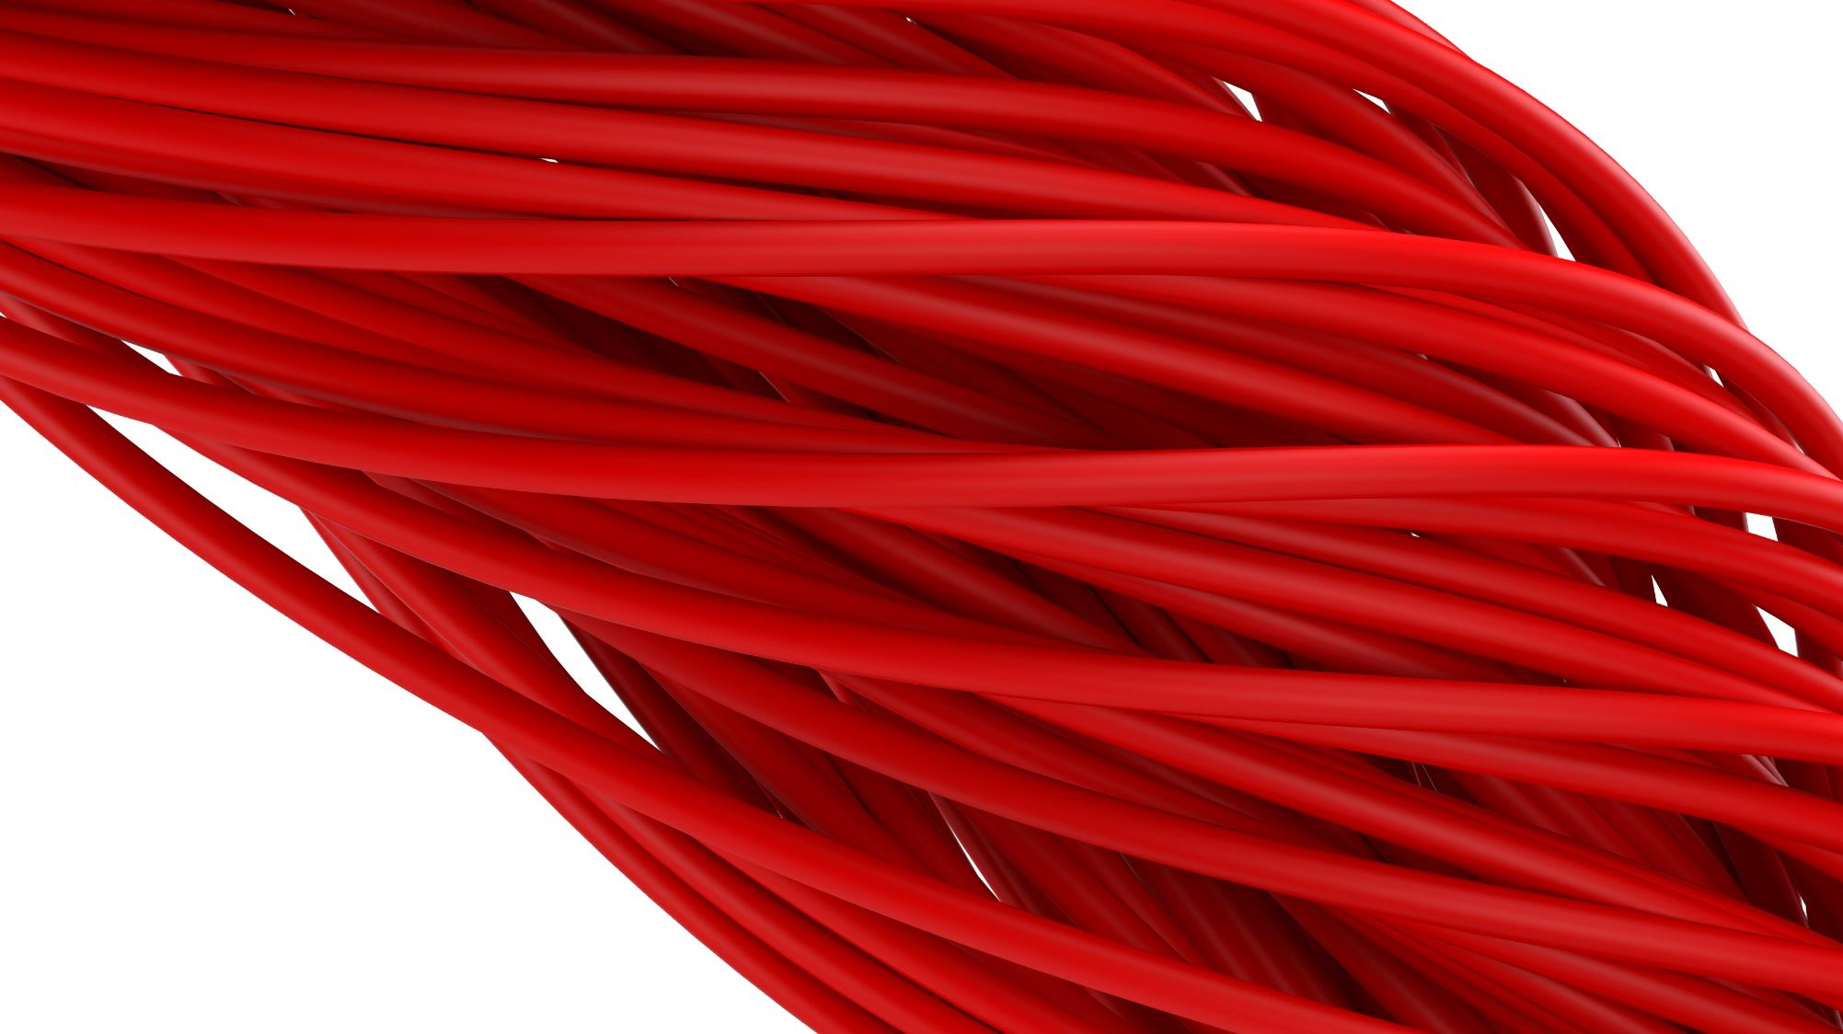
Advantages
Since the cousin of the current regulator is the prestigious voltage regulator, current regulators tend to be cheap since they contain many of the same parts. This also means that they have a tolerance for larger voltages and power loads. Another advantage is that current regulators can also work with either alternating current (AC) or direct current (DC). In terms of designing an integrated circuit, current regulators allow for flexibility in the parts used and where they are placed.

Slide 5
Disadvantages
Referring to the diagram on the circuit card, this specific configuration “allows the flow of quiescent current from the regulator to the load in addition to the regulated output voltage. This introduces an error which may not be permissible in certain applications” (Odunlade, 2019). On top of this, there is high power dissipation because of the large voltage drop across the resistor. This can increase costs because larger parts would be needed. Luckily, there are a few different variations of current regulators.

Slide 6
Variations of the circuit
When it comes to current regulators, there are a few main designs. One incorporates using an LDO as the current regulator which is the integrated circuit on the circuit card. Another design is to use transistors to regulate the circuit. This design uses two transistors, a control transistor and a power transistor. The voltage drop triggers the control resistor which then changes the conduction of the resistor. A third design of a current regulator uses an operation amplifier which can deal with the large voltage drop by feeding it into the operation amplifier.

Slide 7
References
Keim, R. (2018, February 12). Need a Current Regulator? Use a Voltage Regulator! All about Circuits. https://www.allaboutcircuits.com/technical-articles/need-a-current-regulator-use-a-voltage-regulator/
Odunlade, E. (2019, June 5). Current Regulators: Construction, Working and Design Types. Circuit Digest. https://circuitdigest.com/tutorial/current-regulators-construction-working-and-design-types
Prater, M. (2023). Circuit Cards. Github.io. https://praterma2.github.io/circuitCard.html
Wikipedia Contributors. (2019, May 26). Voltage regulator. Wikipedia; Wikimedia Foundation. https://en.wikipedia.org/wiki/Voltage_regulator
Wikipedia Contributors. (2022, November 1). Current source. Wikipedia. https://en.wikipedia.org/wiki/Current_source

